Slide 1
PowerShell Internal Meetup – Docs Update
May 2021

Slide 2


Meet the PowerShell-Docs Team
What we do
Work with the PowerShell team to document the product
Set the standards for PowerShell documentation at Microsoft
Host Office Hours to support folks like you
Work to improve the PowerShell publishing pipeline
Sean Wheeler
Sr. Content Developer
Lead Writer
Chase Wilson
Content Developer
Contact: psdocsteam@microsoft.com

Slide 3
New content published
Documentation for modules that are not officially part of the PowerShell product, but they are maintained by the PowerShell product team.
Microsoft.PowerShell.Crescendo
Microsoft.PowerShell.SecretManagement
Microsoft.PowerShell.SecretStore
PlatyPS
PSScriptAnalyzer

Slide 4
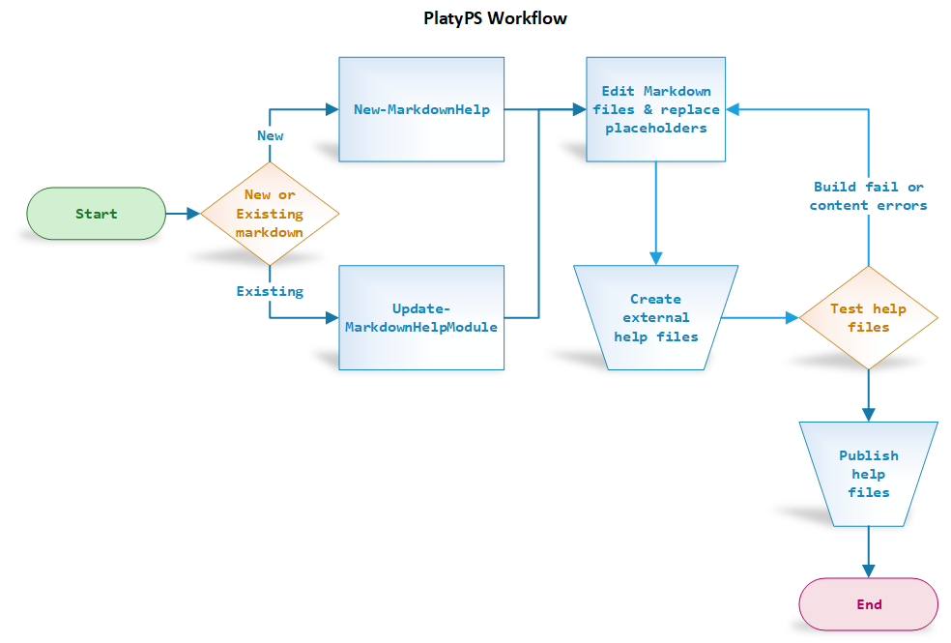
Creating & Updating cmdlet reference
See the onboarding docs for more detailed information
Updating existing PowerShell modules - Repo Admin Guide | Microsoft Docs

Slide 5
CabGen – simplifying Updateable Help
What is CabGen?
New service from the Docs engineering team
Provides a pipeline for continuous publishing of Updateable Help content from your Markdown docs source
Simplifies HelpInfoUri management for your modules
1 Uri for all modules in a release
Still working on making the setup be self-service
Get onboard Before your next release
Contact Jason Helmick to setup consulting and onboarding sessions
Read the the admin guide - Set up updateable help CAB files - Repo Admin Guide | Microsoft Docs

Slide 6
PowerShell-Docs Office Hours
Get help with your PowerShell documentation
Get answers to:
Docs Pipeline questions
Style and formatting questions
Editorial feedback
Create a community of PS content owners
Share best practices
Unify around a common style guide and editorial checklist
Hosted by the Docs Team
Meets every other Thursday at 11am PST
Join the Office Hours Teams channel

Slide 7



Other projects
 | MS Learn modules for PowerShell Chase is working on new modules New content available
 | PowerShell Community Blog – Coming Soon! Replaces the Hey Scripting Guy! Blog A place for the community to learn PowerShell and share insights See the wiki for information about how to contribute
This Photo by Unknown Author is licensed under CC BY-NC

Slide 8
Call to Action
Get onboard the CabGen Pipeline
Follow the PowerShell-Docs Style Guide
Participate in Office Hours
Contribute to the Community Blog

Slide 9
Links
Name | Link
Contact the PowerShell-Docs team | psdocsteam@microsoft.com
Documenting PowerShell Modules | https://review.docs.microsoft.com/en-us/help/onboard/admin/reference/powershell/documenting-modules?branch=master
Set up updateable help CAB files | https://review.docs.microsoft.com/en-us/help/onboard/admin/reference/powershell/update-help?branch=master
PowerShell-Docs Contributor Guide | https://docs.microsoft.com/powershell/scripting/community/contributing/overview
Office Hours Meeting | https://teams.microsoft.com/l/meetup-join/19%3a8d934148e8844415ad566424cb3b5a89%40thread.tacv2/1611324301377?context=%7b%22Tid%22%3a%2272f988bf-86f1-41af-91ab-2d7cd011db47%22%2c%22Oid%22%3a%228b895b7b-8e8a-4413-8039-92948f5315b9%22%7d
Office Hours Teams Channel | https://teams.microsoft.com/l/channel/19%3a8d934148e8844415ad566424cb3b5a89%40thread.tacv2/PowerShell-Docs%2520Office%2520Hours?groupId=19383f1d-32e9-4dbe-9882-be1ffb4248a2&tenantId=72f988bf-86f1-41af-91ab-2d7cd011db47
MS Learn - PowerShell modules | https://docs.microsoft.com/en-us/learn/browse/?terms=powershell

